Slide 1
Interactive Expressions Analyst
- Your Right Emotion Brings you your Right Time.
Team Members: Anagha Kelkar, Mukesh Poptani, Raj Thaker, Yash Vora.

Slide 2

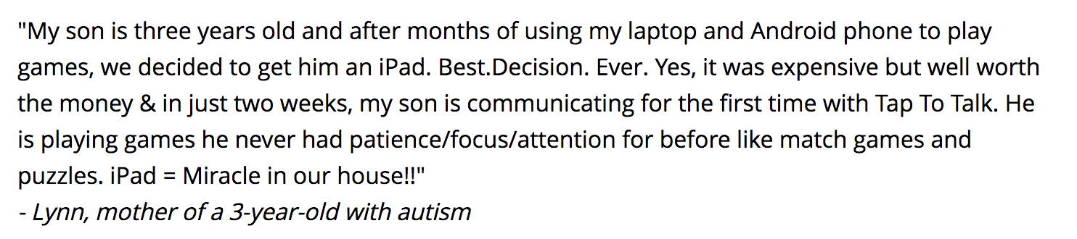

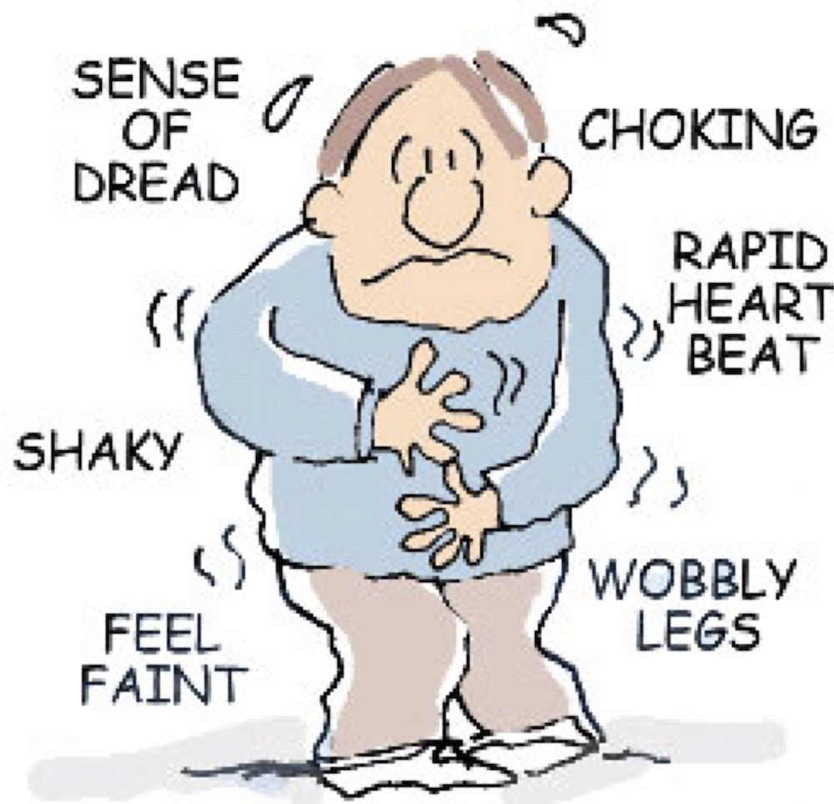
Why Interactive Expressions Analyst
Technology
and
Autism:
https://www.autismspeaks.org

Slide 3
What is Interactive Expressions Analyst?

Slide 4
Tech Stack
Team Culture!
API
4 Members
Experience from 3 different Companies
Working 2 Days of Hackathon
To Achieve 1 Goal!

